Slide 1

Books SW
Team 3 Group 1

Slide 2
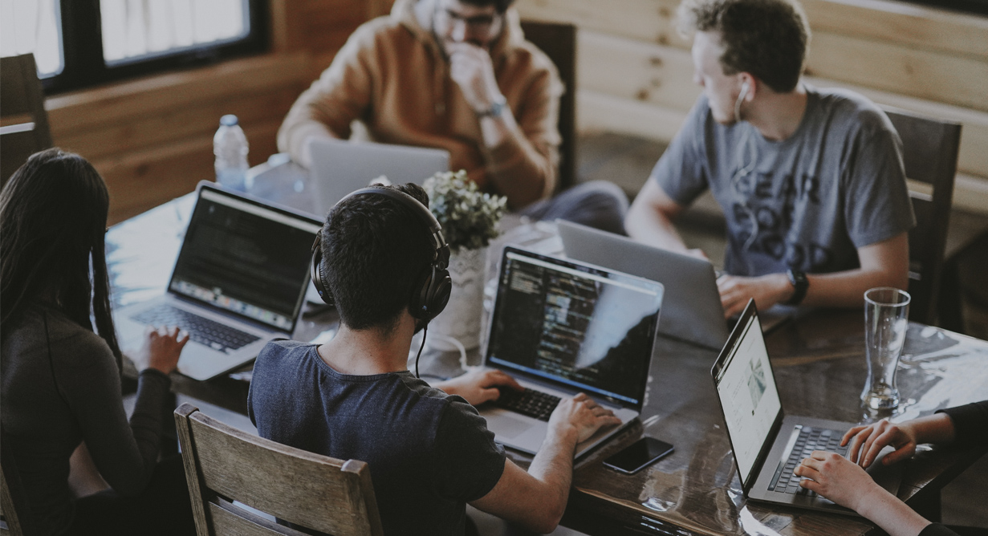
Team Roles
Tamuka Mutasa
Project Manager
Thuraya Almutairi
Head of Documentation
Ethan Harris
Chief Technology Officer
Metin Konde
Head of Operations

Slide 3
Contents
Team roles
Project details
User Requirements Survey
Flowchart
Development approach
Team communication
Data protection & Privacy

Slide 4
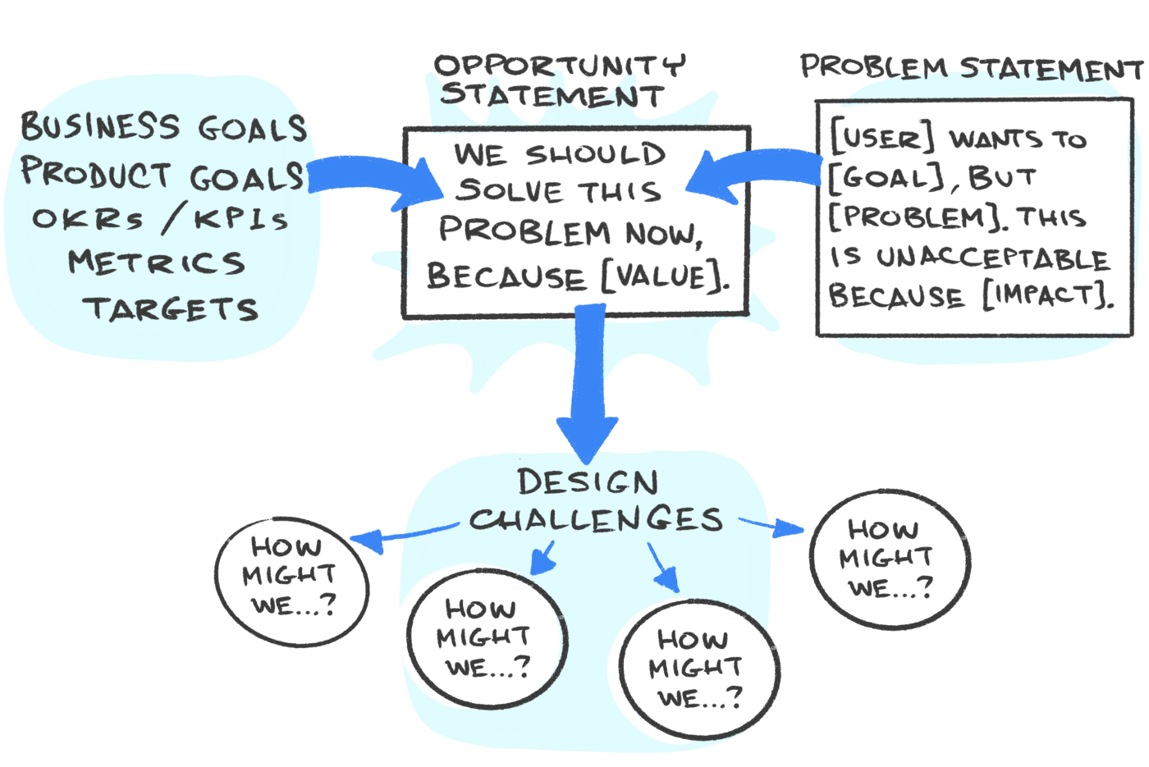
What Problem Are You Solving?

Slide 5
User Requirements Survey
"The current system has a problem where students can still book for books or equipment that are not currently available"
- Jenna Hicks (Advice Zone Assistant)
"Whenever you want to book for a study space that is more than 2 hours long you have to book 2 separate sessions" - Nicole Business School (student)
"USW Bookings tends to crash on checkout and I have to authenticate again through my student account to get it to work" - Student in Faculty of Civil Engineering

Slide 6

Introducing...

Slide 7
Project Details
We are developing a library booking system
For management of library records
Removes the need for manual record keeping
Important for large libraries
Subscription based license model

Slide 8
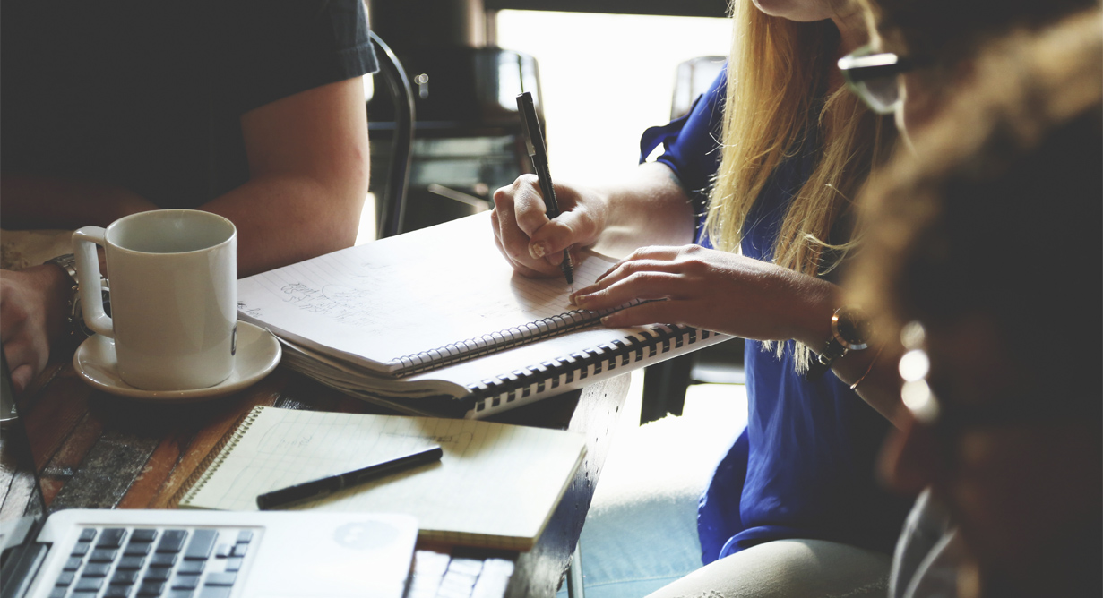
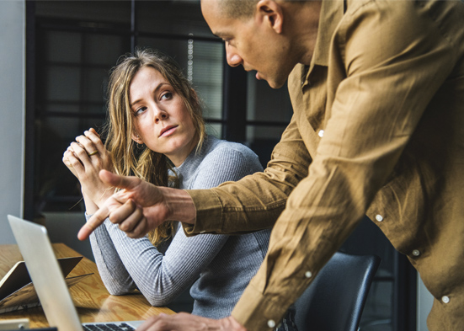
Main features
Librarian can add or remove books/users
Members can see and checkout available books
Administration of fines for late return and lost books
Prevents bookings of items out of inventory

Slide 9
Features & System Requirements
Mac OS Yosemite or Windows 8, 2G RAM and 300MB free space
Feature to allow users to stay logged on their device
The application is being written in C#. C# has better supports for web application compared to C++and Python

Slide 10
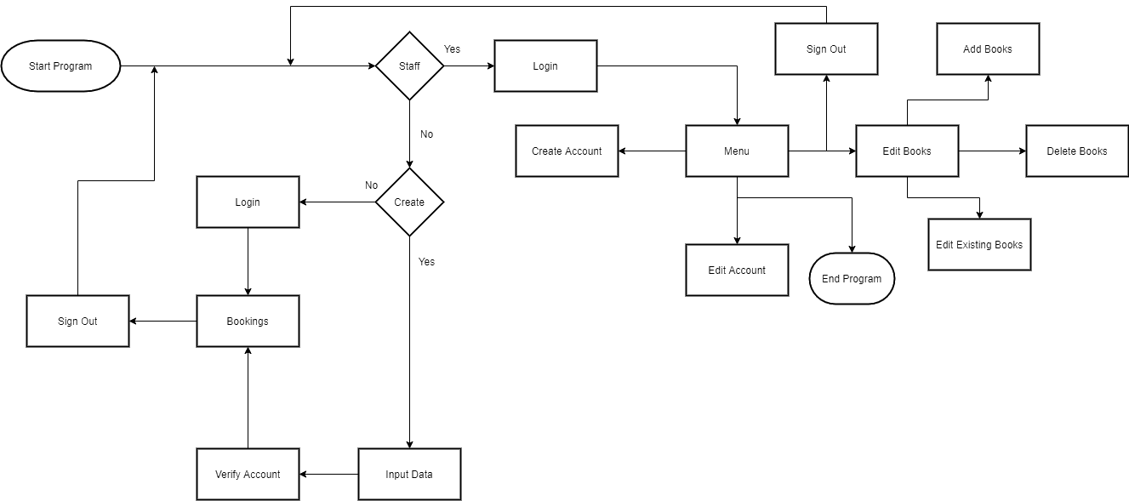
Program Flowchart

Slide 11
Development approach
The software is being developed using agile development
This is an iterative approach to software development
GitHub is used to track the iterative changes made by team members and for collaboration
Trello is used for project management
Pair programming is used to ensure great code quality

Slide 12
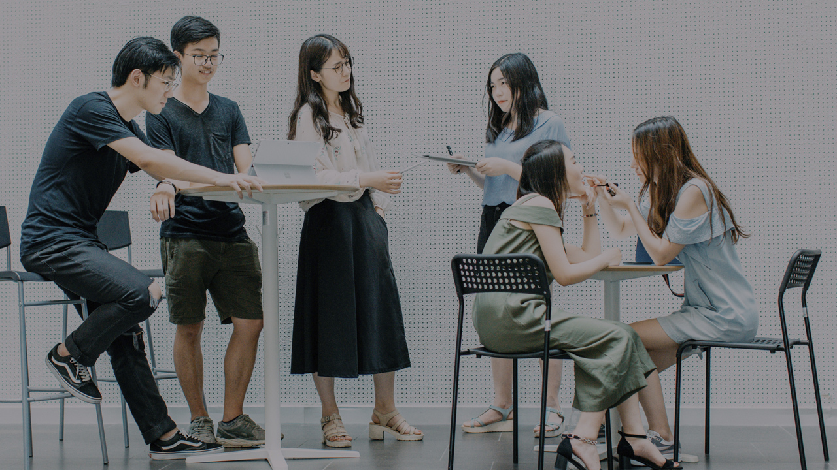
Development Approach (cont’d)
Unit testing are written to make sure each individual functions work well
On completion of the software, integration testing will be done
Finally, user acceptance testing will also be conducted
The documentation of the software will be written once the user approval has been given

Slide 13
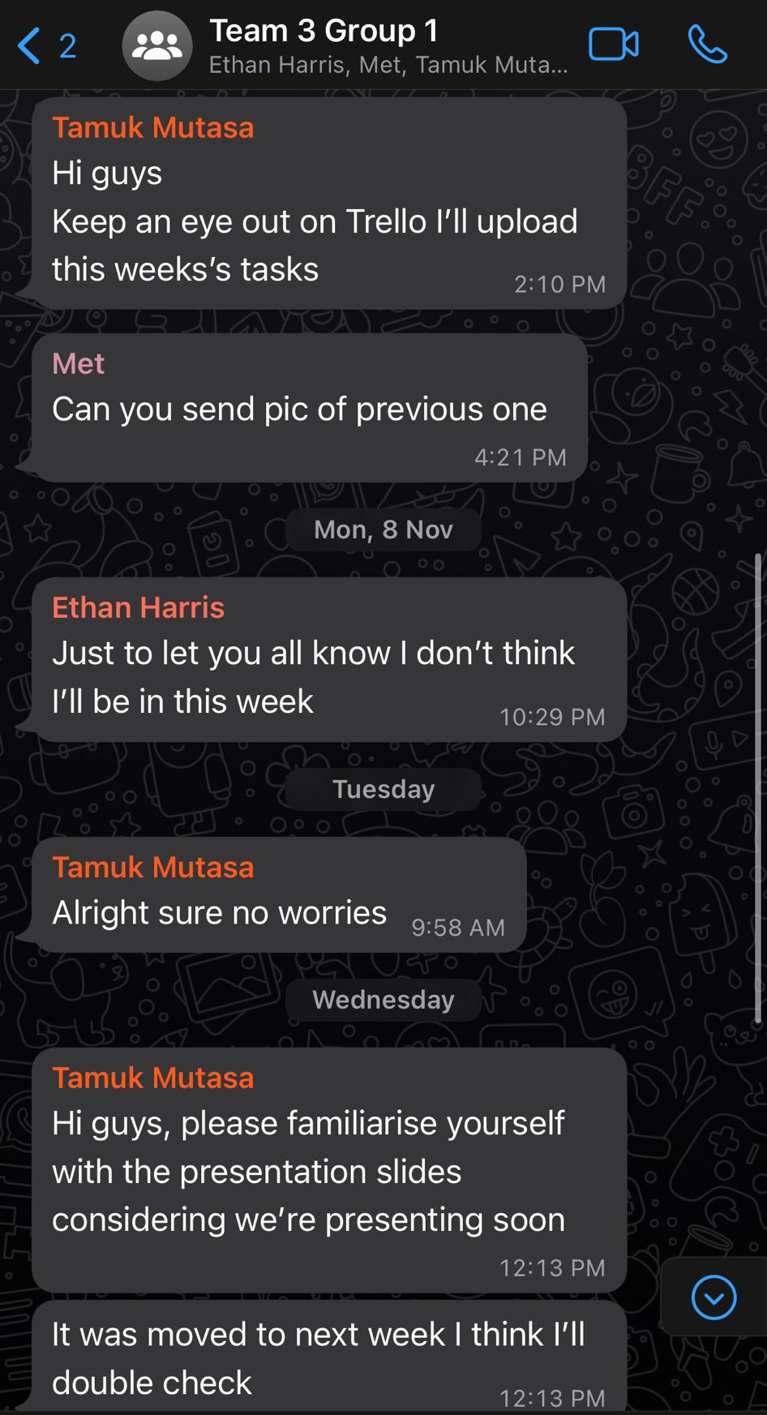
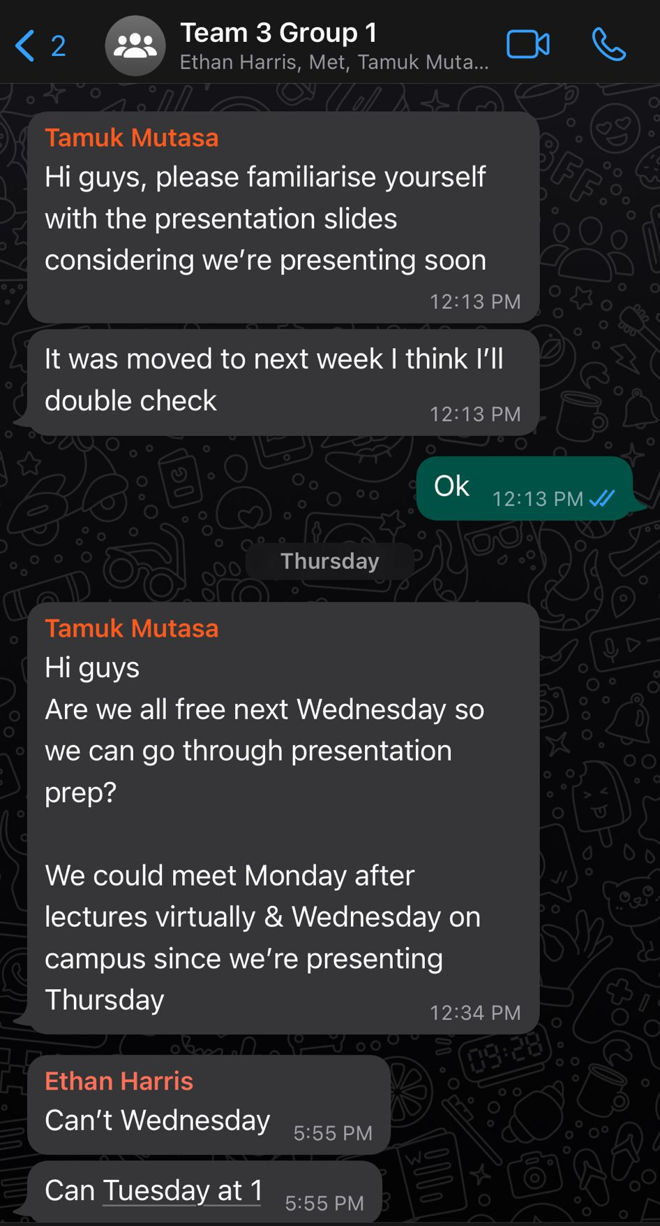
Team communication
Trello
WhatsApp group
GitHub (collaboration)

Slide 14
Data Protection & Privacy
Users' data are encrypted and stored in password protected database
Two factor authentication will be implemented to better secure the data
Users can request copy of their personal data
Users can correct/amend incorrect personal information
The program will only request and store information necessary to administer booking for the user
Users have the right to request deletion of their data from the system
This will result in account termination
All borrowed books must be returned before this is completed

Slide 15
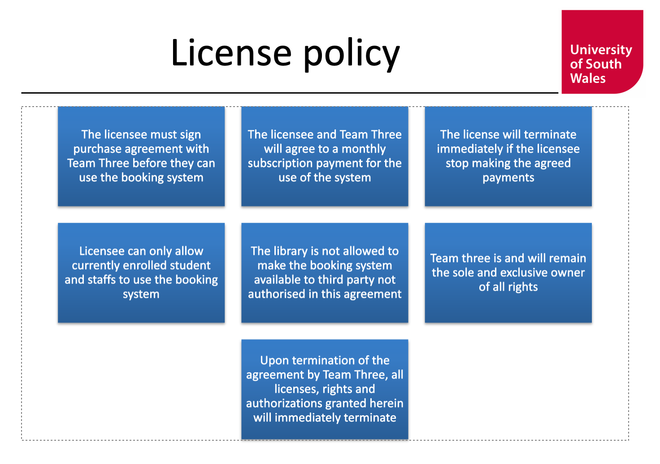
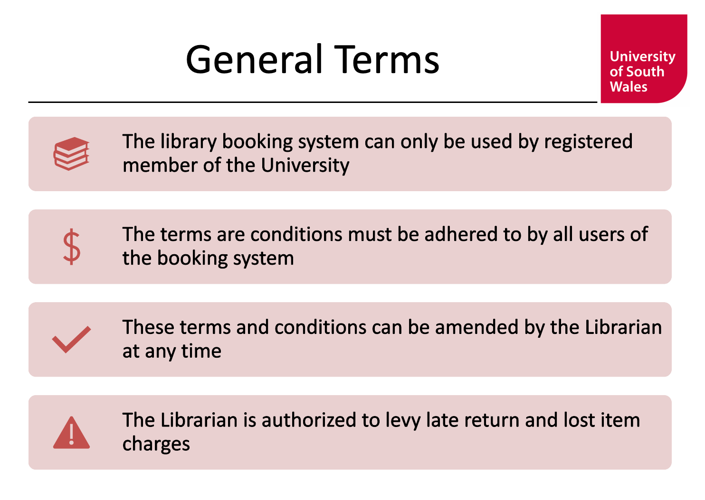
Terms & Conditions Overview (LSEPI)

Slide 16
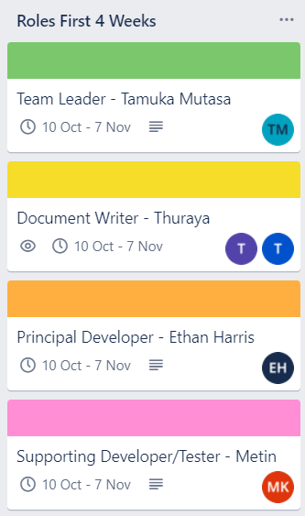
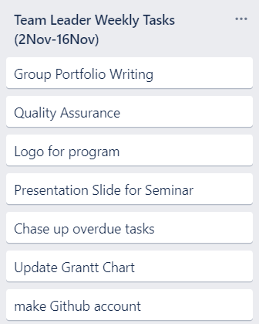
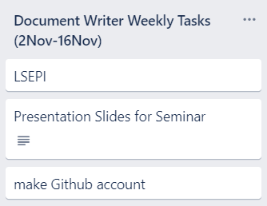
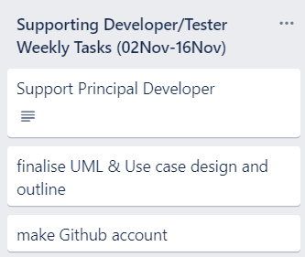
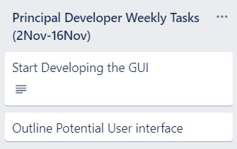
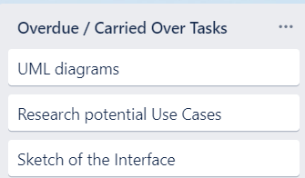
Trello Tasks

Slide 17
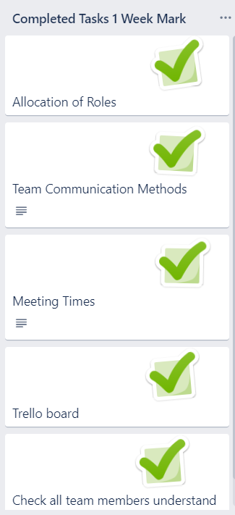
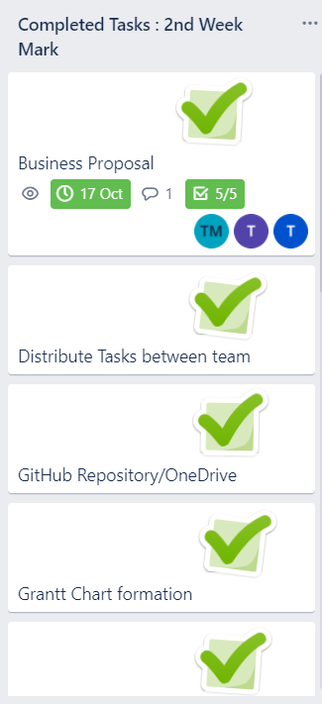
Trello Tasks

Slide 18

Thank You!

